Slide 1

AMP Digital Display Campaign Strategy: Building Awareness and Driving Sales

Slide 2
Understanding the Audience
Target Audience:-Working Professionals, students, Housewives.
Online presence:-Career websites, social media, educational platforms, news sites.
Key Message: AMP Digital provides quality digital marketing training to empower individuals and unlock their career potential for their bright future.

Slide 3
Campaign Objectives And Its Types
Objectives: Build brand awareness & drive sales of AMP digital marketing programs.
Campaign Type: Multi-channel Display Campaign with a mixture of:
1)Brand Awareness Ads: Promote this brand and reach a broad audience.
2)Lead Generation Ads: Drive targeted traffic to landing pages and promote your courses which the customer want.
3)Retargeting- Ads: Re-engage website visitors who showed interest but didn't convert, by offering some discounts or by specifying different success stories.

Slide 4
Targeting Strategies:
Demographic Targeting: Typical Age Group, Location(where demand is more ,supply is less)
Interest targeting: People interested in Entrepreneurship, startups, small businesses.
Platforms: Social Media like Facebook, Instagram, X.com, LinkedIn to name a few(social media advertisement/marketing),Google Display ads(Youtube ads).

Slide 5
Highlighting Quality
Ad Headlines: Focus on gaining attraction(Headlines)-[Unlock your true potential by joining AMP Digital’s Digital Marketing training.]
Some Visuals: By promoting the success stories of different students and their journey, by creating videos and testimonials and publishing on the website.
Landing pages: Showcase landing pages and creating engaging landing pages, and clear call to action for enrollment.

Slide 6
Measurement of Campaigns
Tracking Campaigns Performance: Impressions, clicks, conversions, cost- per- acquisition (CPA), etc
Optimize Targeting: Use statistical testing like A/B testing to compare 2 different ad campaigns.
Continuous Monitoring: Ensure the campaigns align with well defined objectives.

Slide 7
Buyer Persona

Slide 8
Working Professional
Age: 25-45
Education: College degree or professional qualification
Occupation: Marketing, sales, business development, or other related field like even IT professionals.
Motivation: Career transition, increased earning potential.
Challenges: Lack of digital marketing skills, desire for upskilling.

Slide 9
Students
Age: 18-24
Education: College student or recent graduate
Motivation: Prepare for a career in digital marketing, improve employability, upskilling themselves
Challenges: Difficulty finding relevant internships, lack of practical skills, Lack of right platform.

Slide 10
Housewife
Age: 30-50
Education: Varies
Motivation: Start a new career, generate additional income, learn new skills
Challenges: Lack of time and resources, fear of starting over, perceived age barrier

Slide 11
Ad Campaigns
Display Ad campaign
Video Ad Campaign

Slide 12
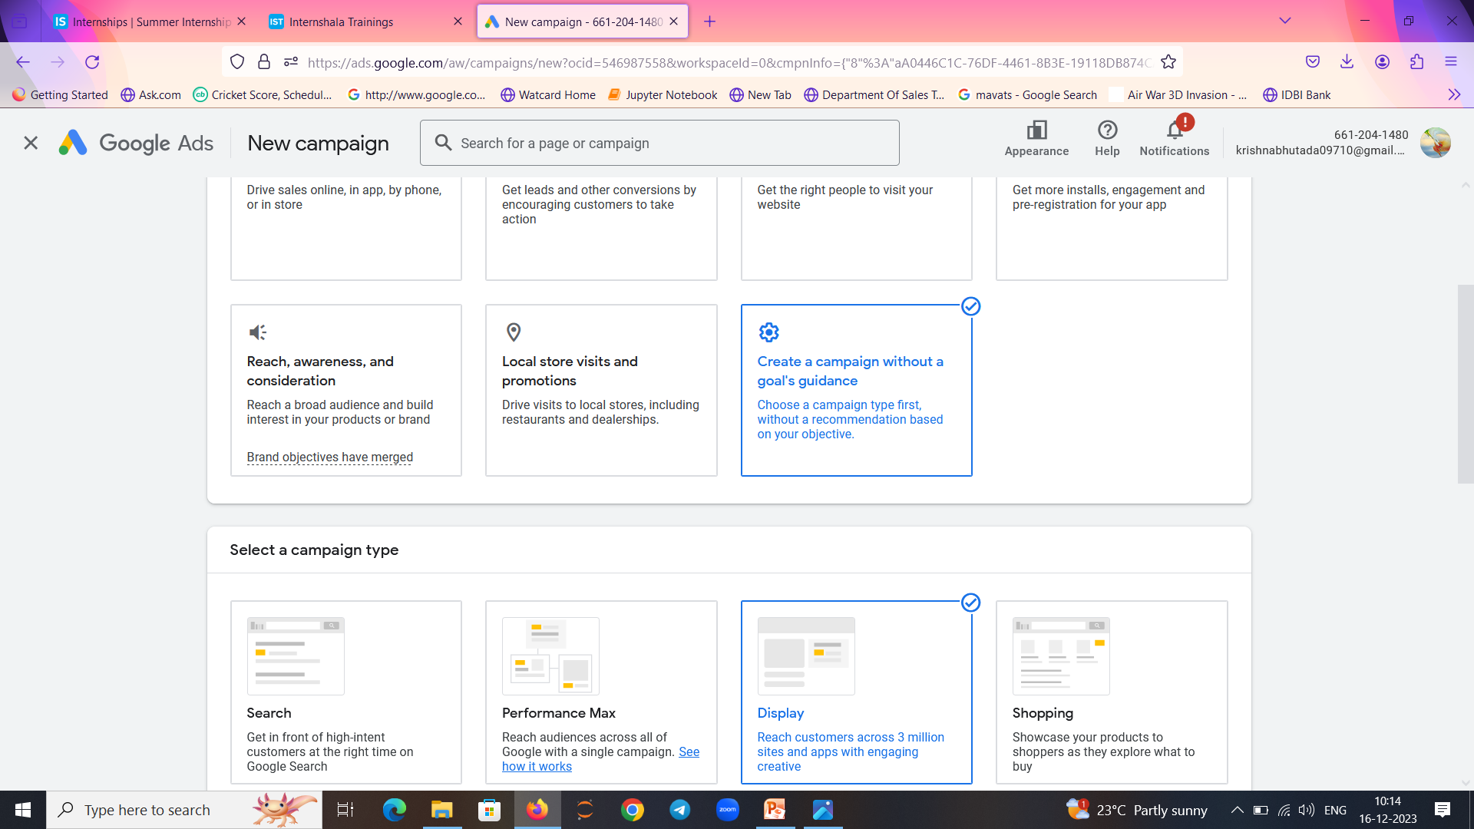
Display Ad:

Slide 13
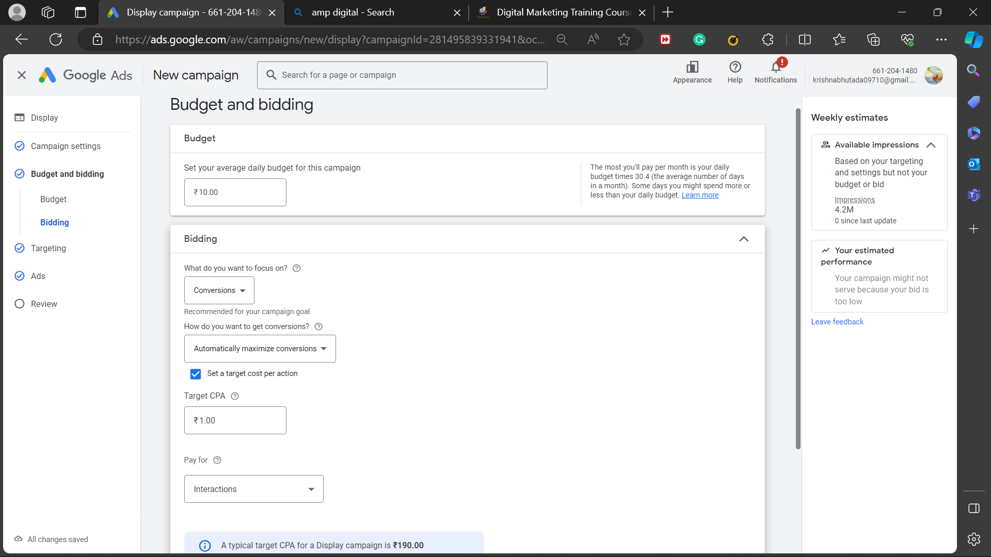
Bidding and Budget:

Slide 14
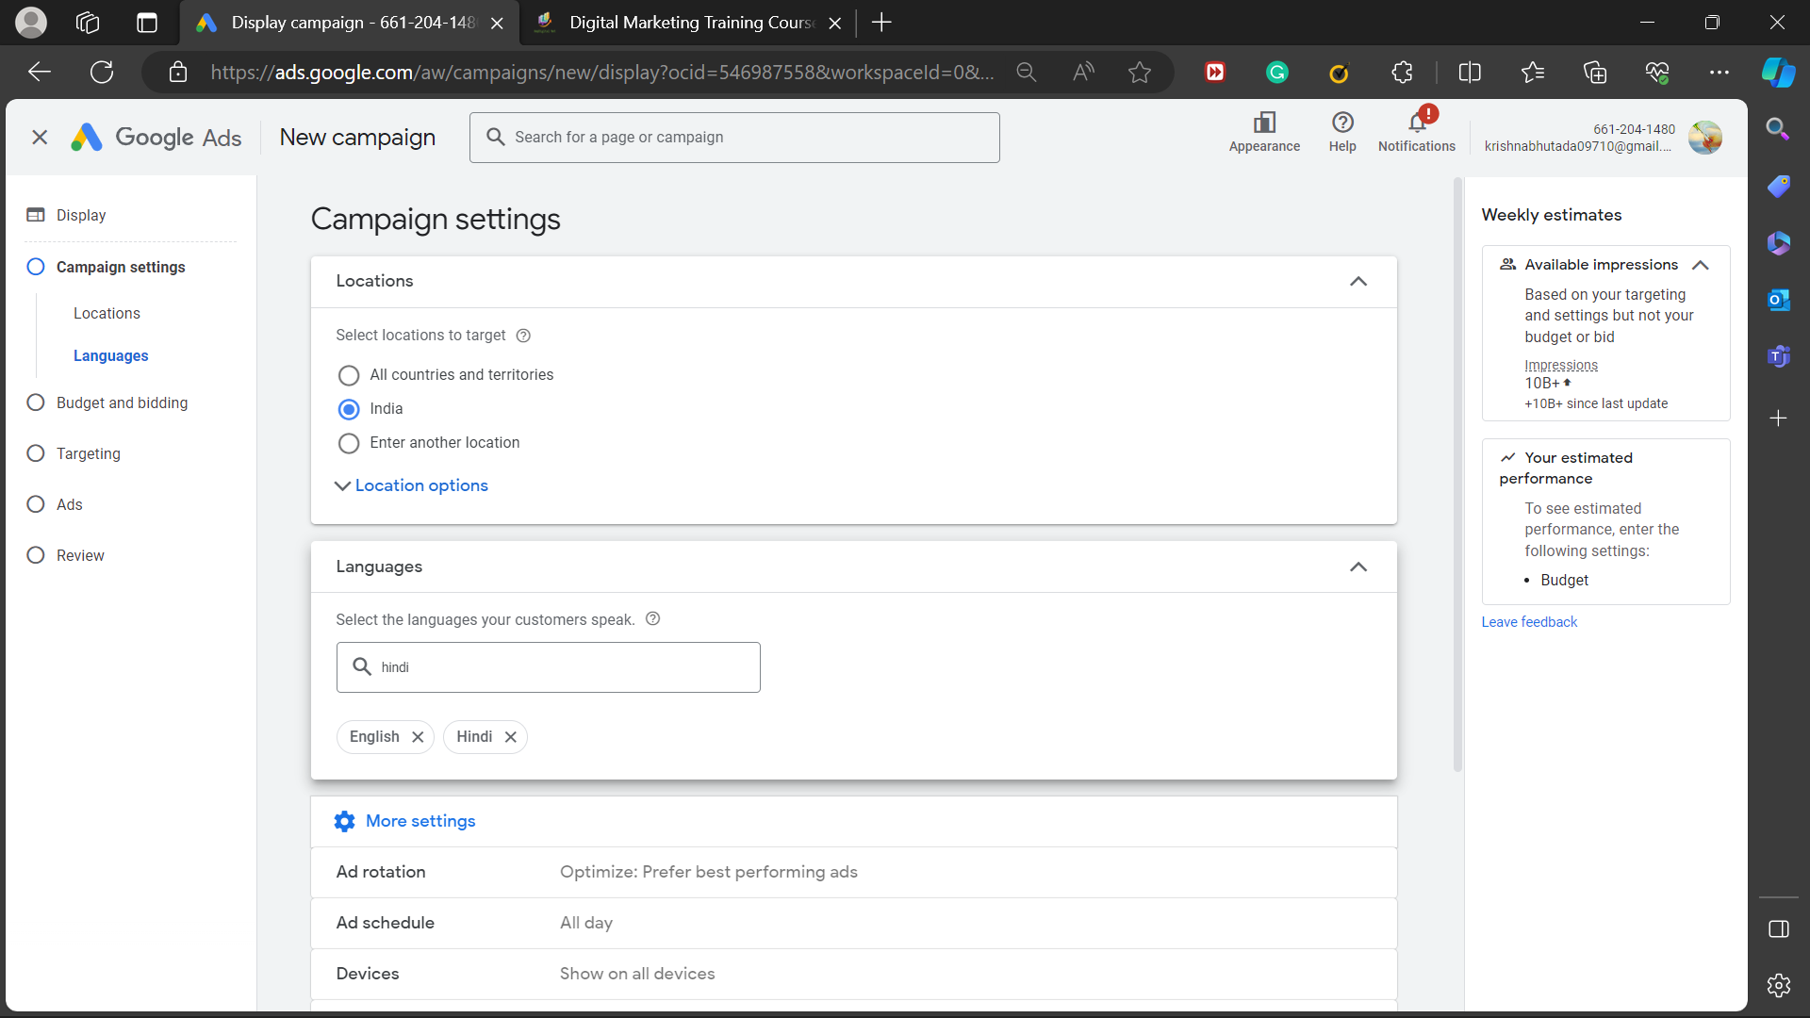
Target Location:

Slide 15
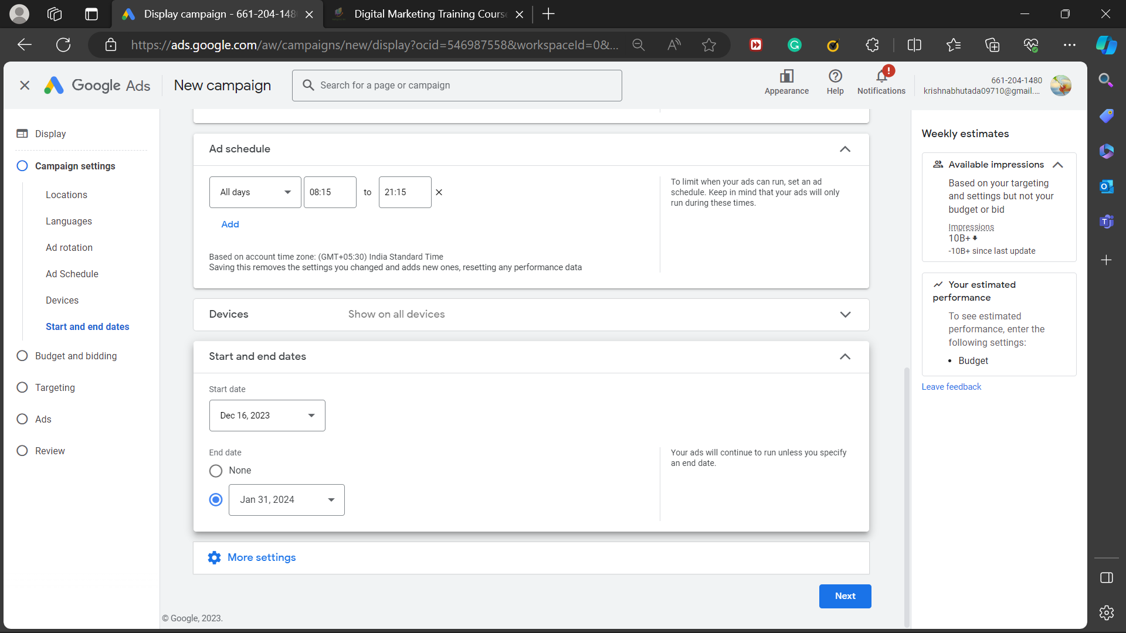
Ad Schedule and Start –End Date

Slide 16
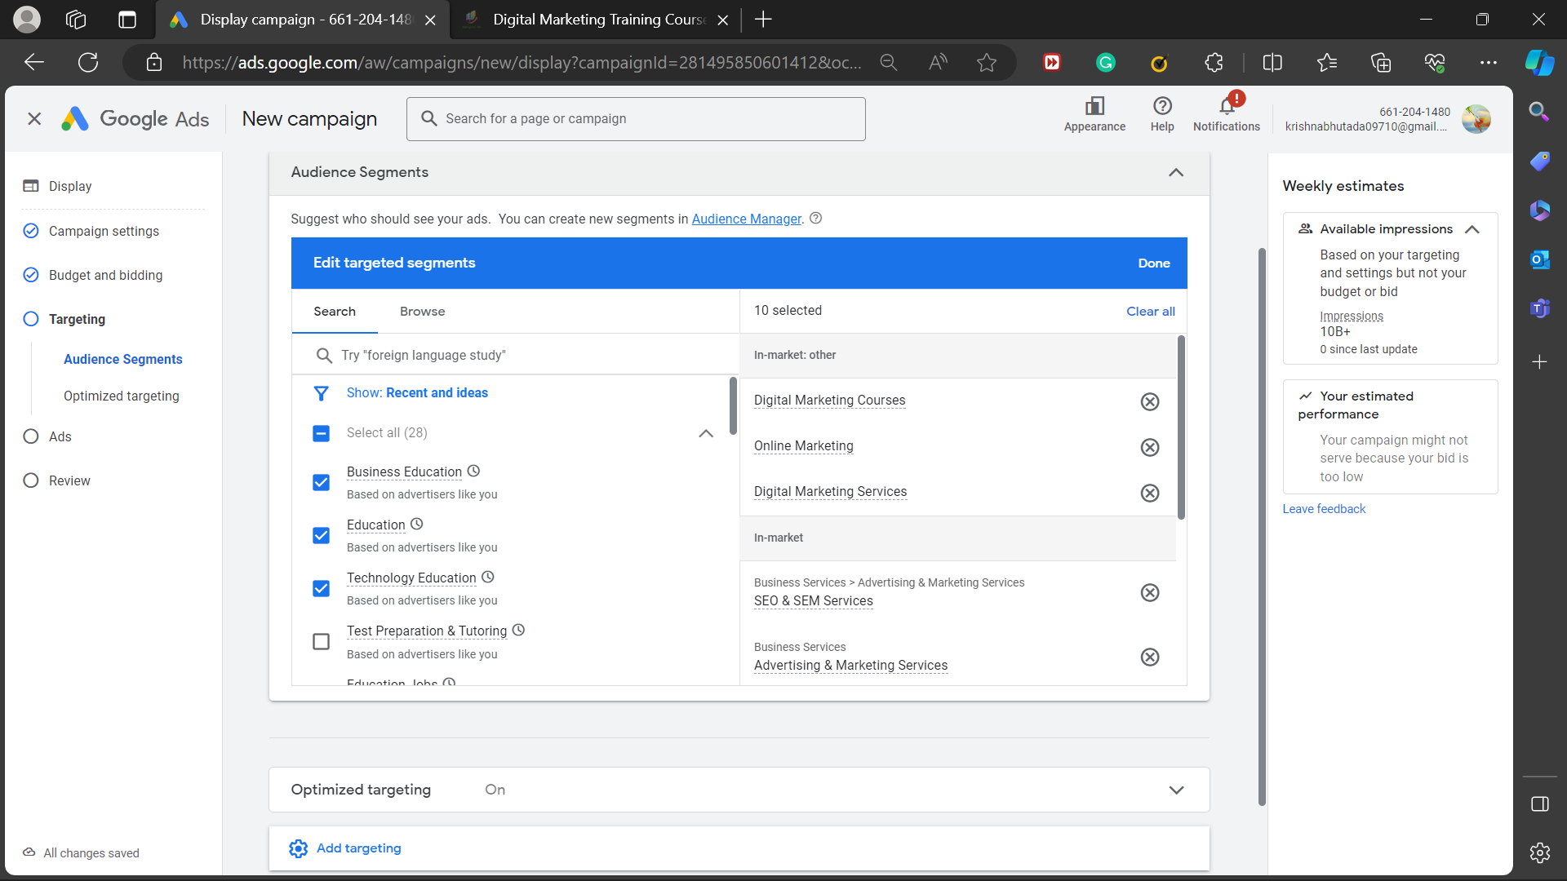
Different Audience Segments

Slide 17
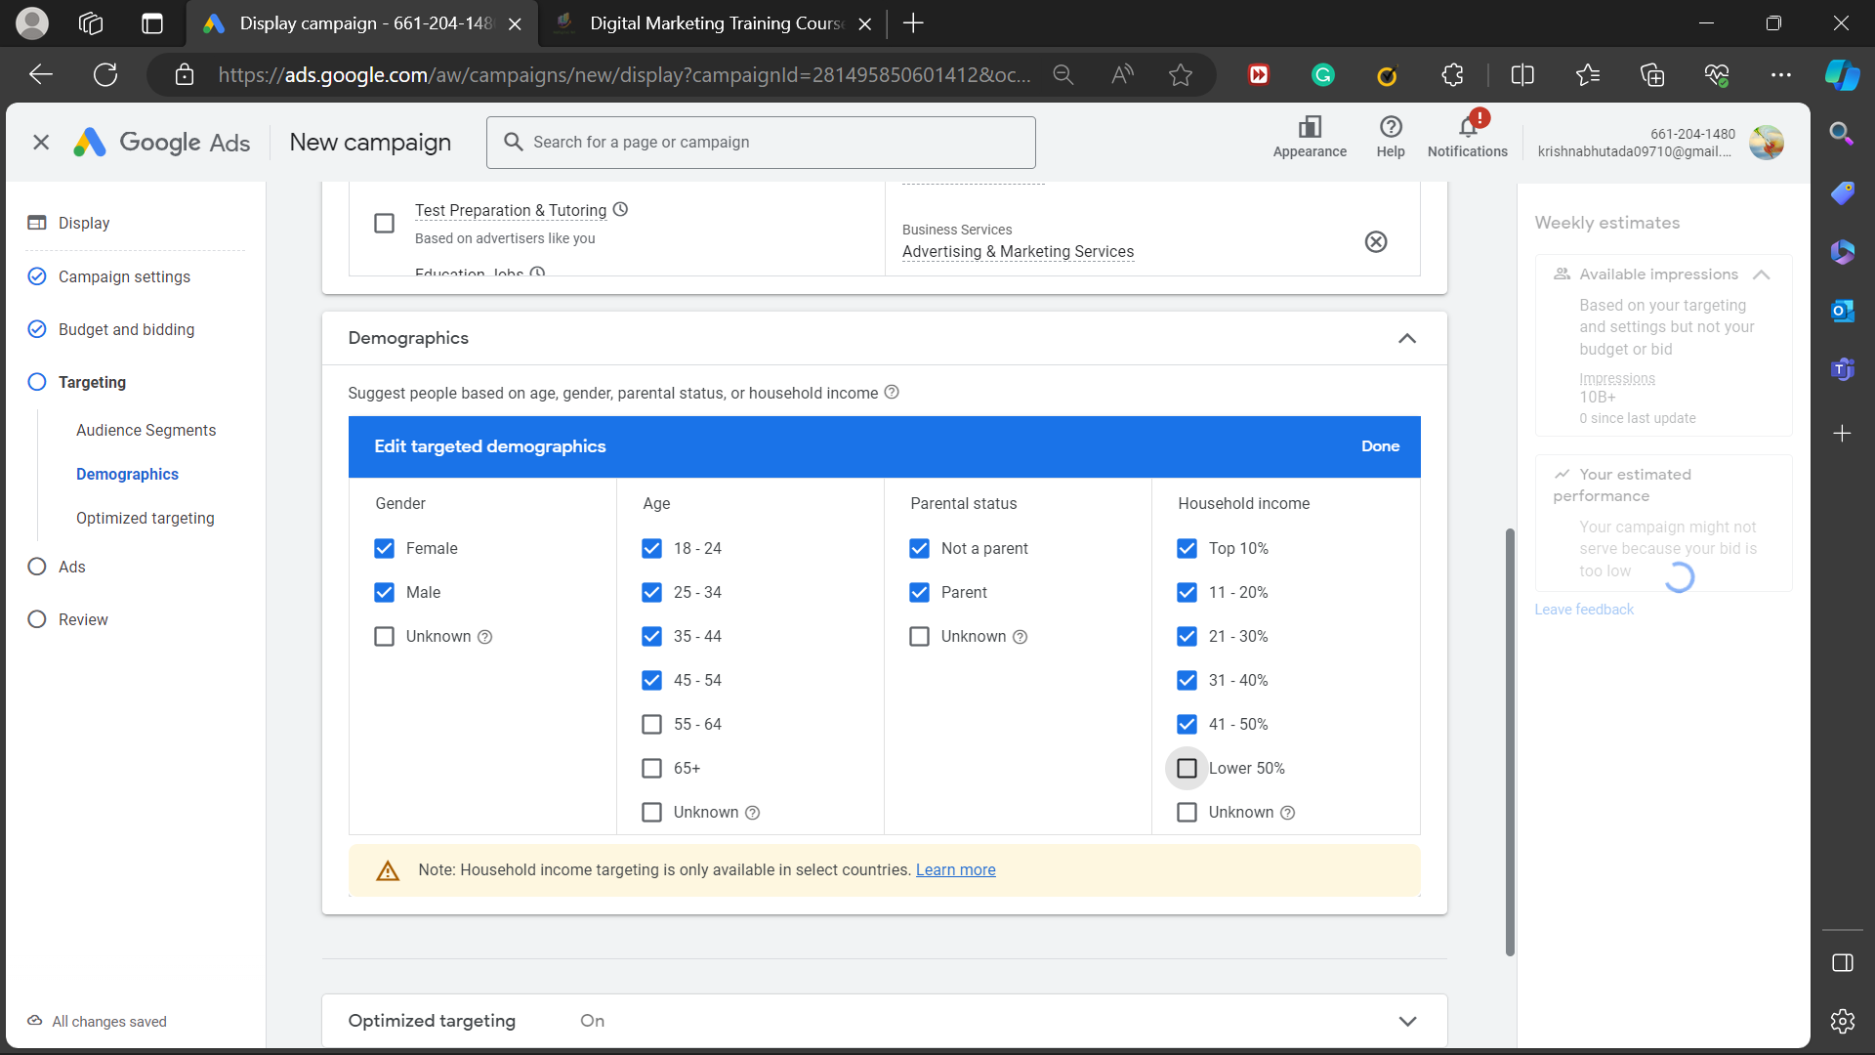
Targeted Demographics

Slide 18
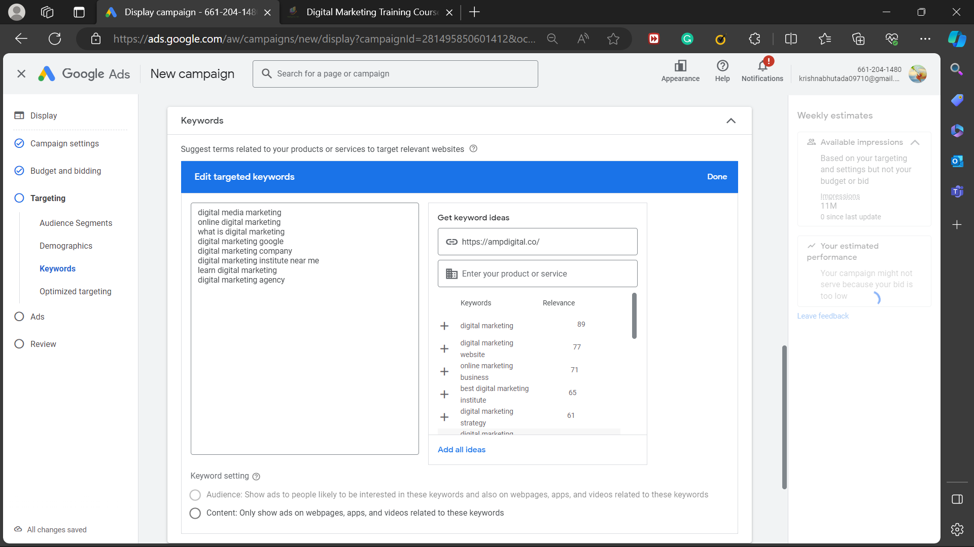
Keywords

Slide 19
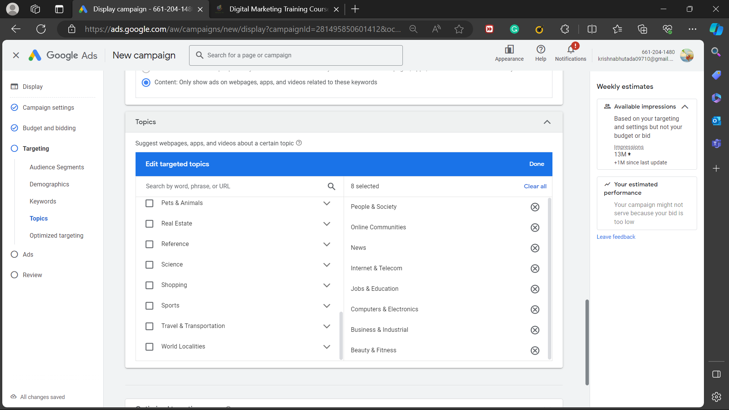
Targeted Topics

Slide 20
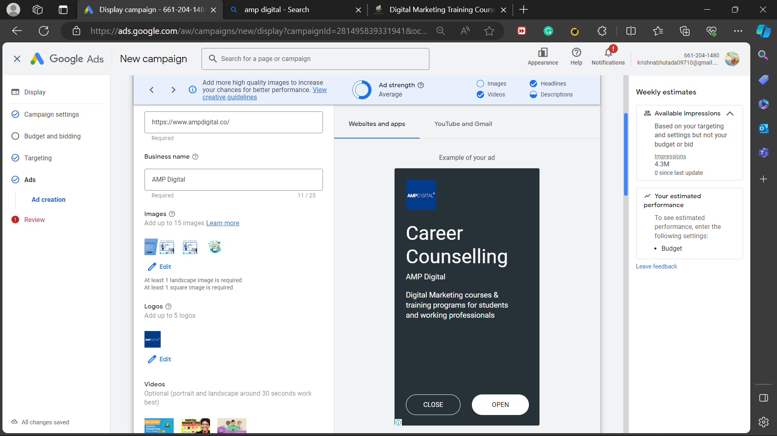
Display Ad for Websites and Apps

Slide 21
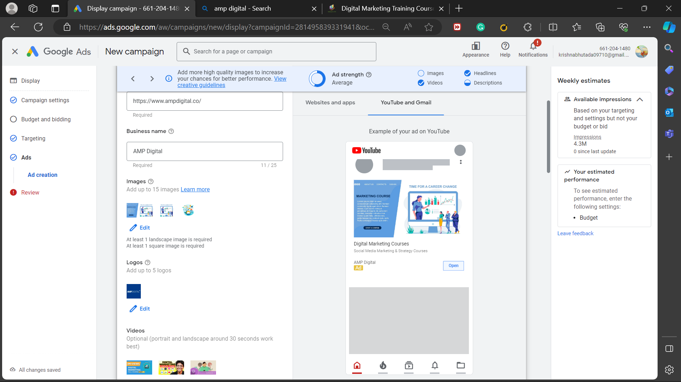
Display Ads for Youtube and Gmail:

Slide 22
Video Display Ad:

Slide 23
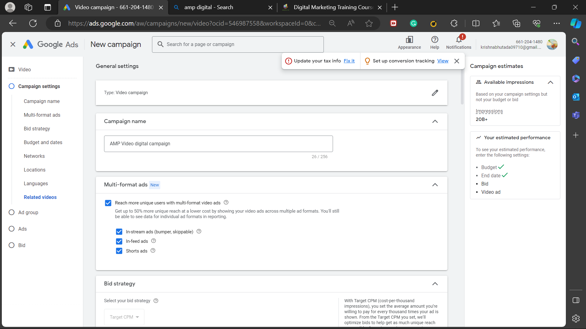
Campaign Settings:

Slide 24
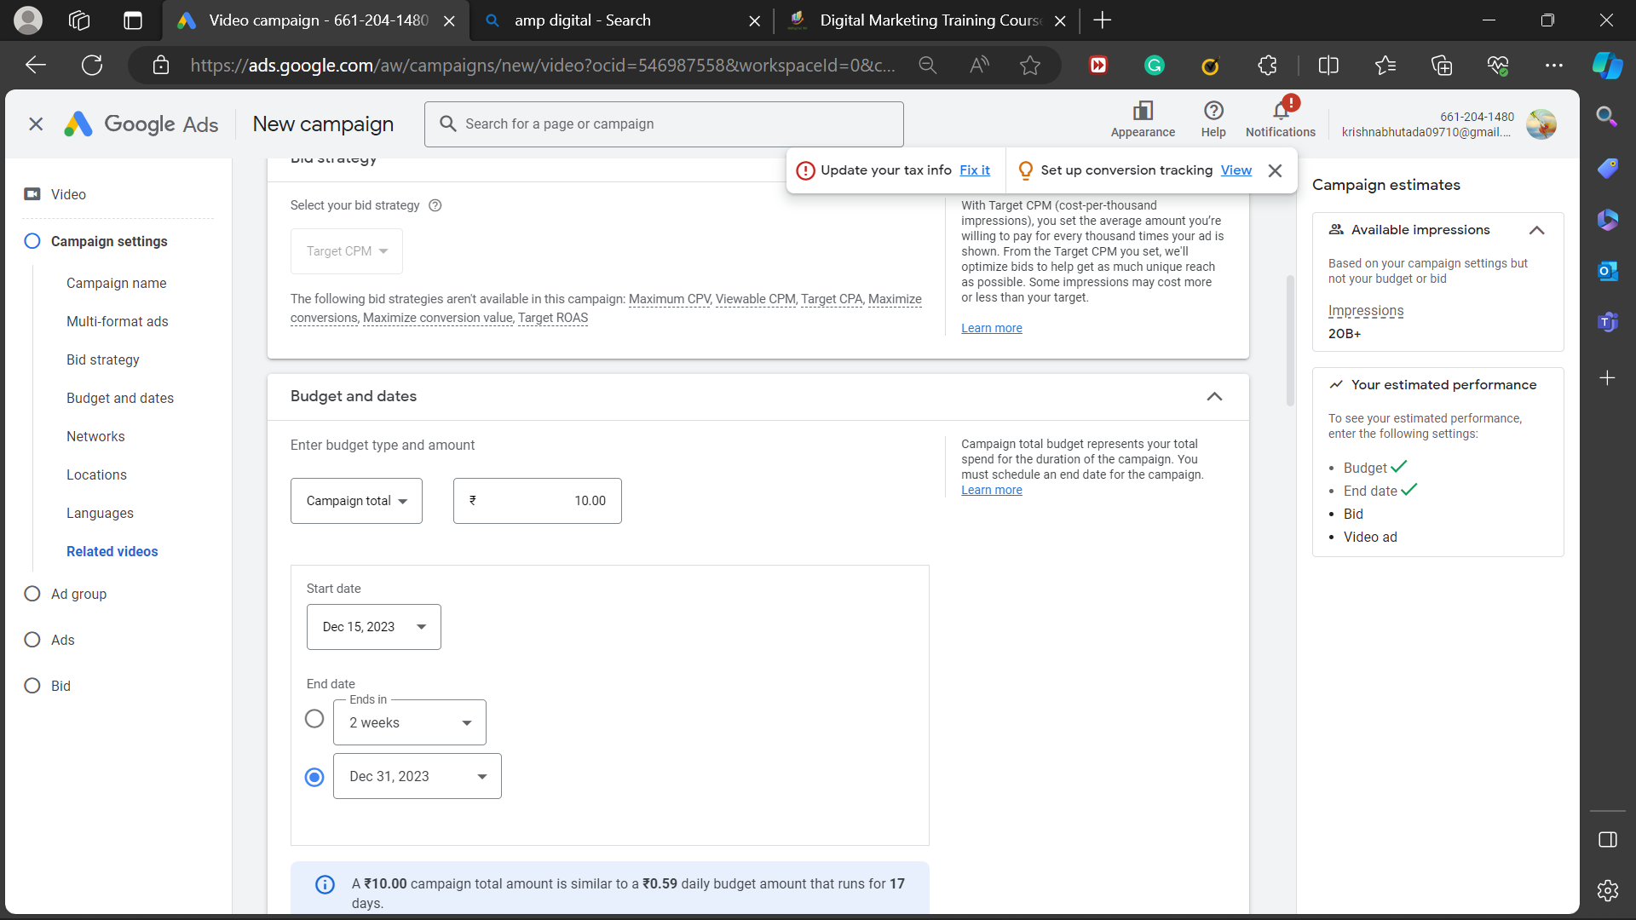
Budget and Bidding

Slide 25
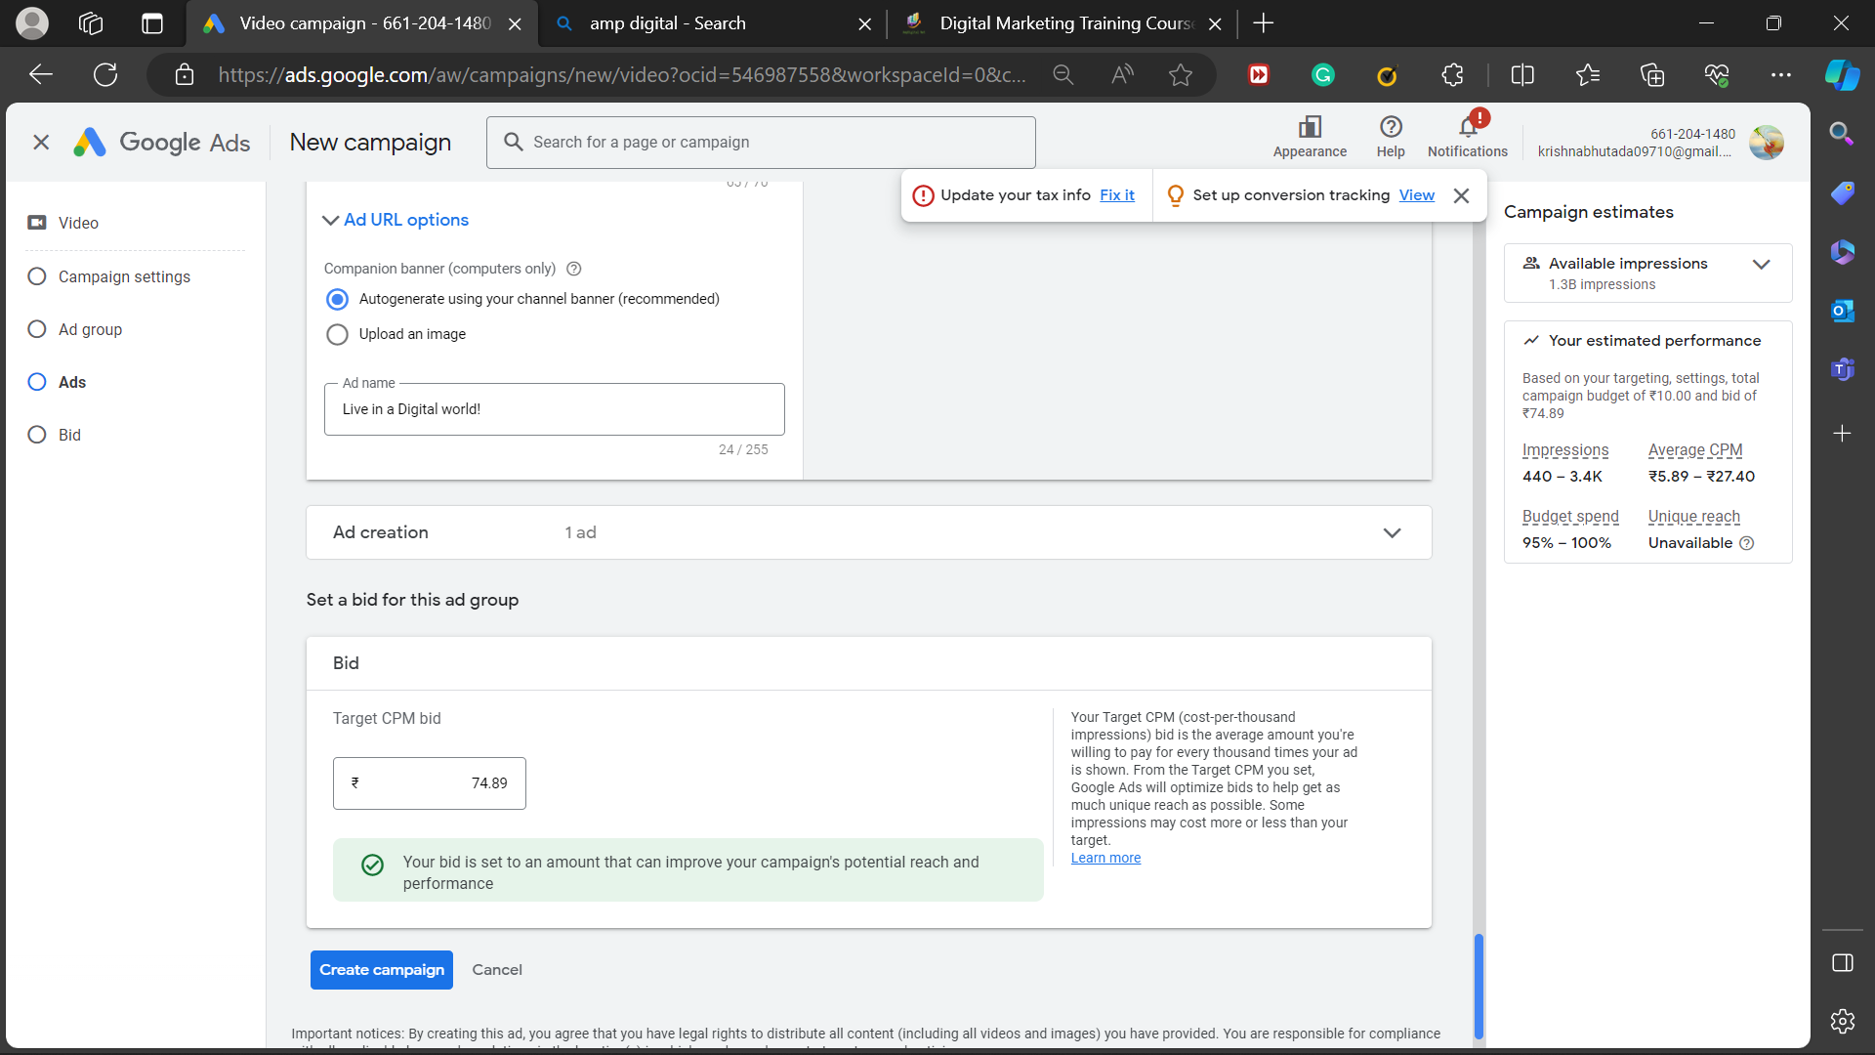
Targeted Bid

Slide 26
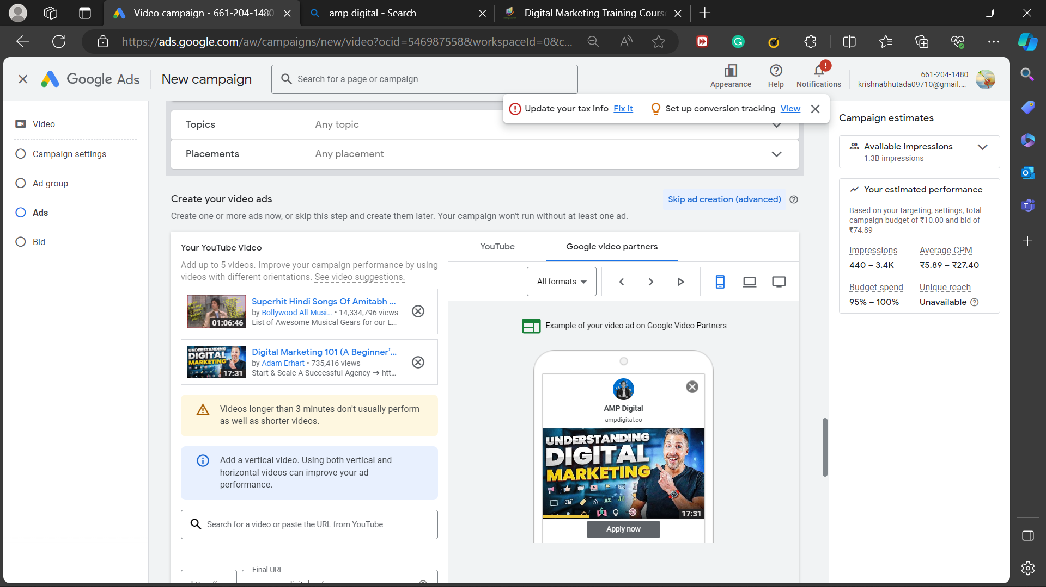
Video Ads Display for Google video partners:

Slide 27
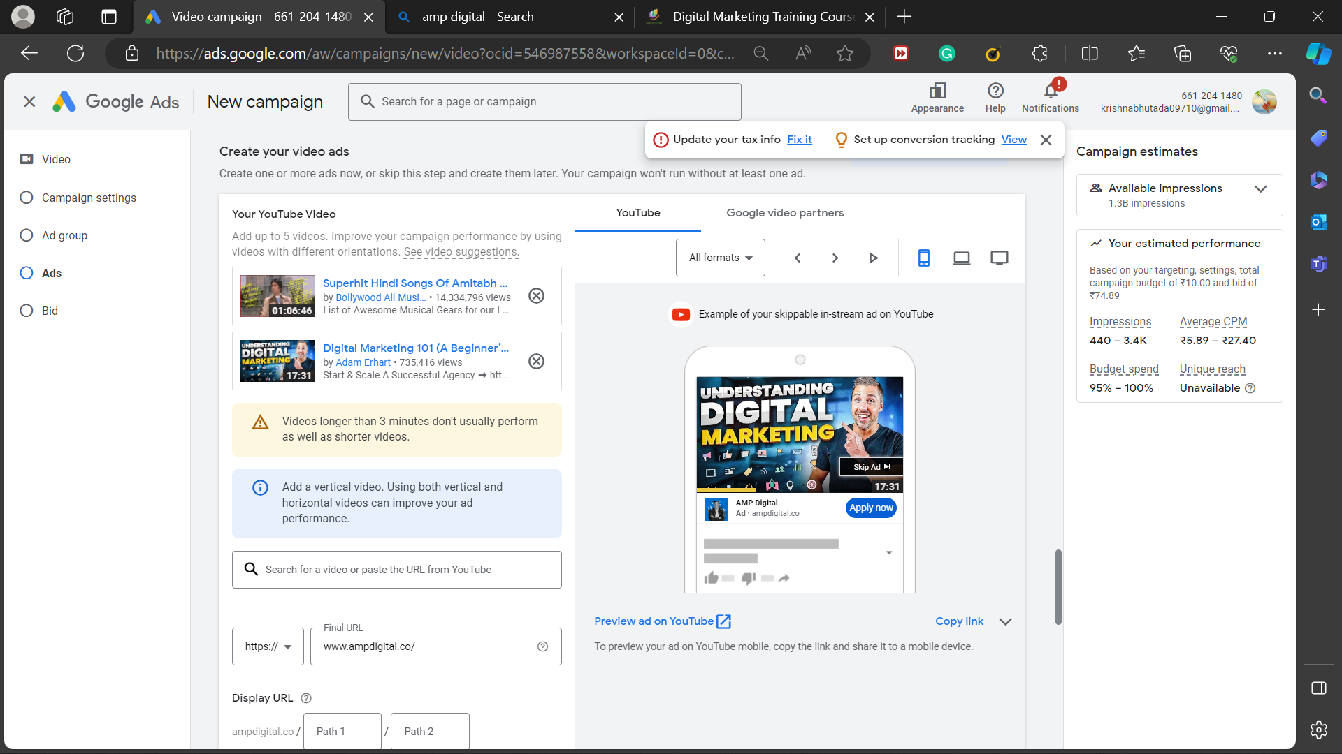
Google Display Ads for Youtube:

Slide 28
Conclusion:
Thus, the Google Display Ads is a powerful tool for any organization to grow their business and to be present digitally. It has a scope to reach a wider audience and provide immense benefits.

